Slide 1
Chapter two
Hardware and software
Instructor: Mr Durodola K.A

Slide 2
Learning objective
Define hardware
Evaluate internal and external hardware devices
Explain the purpose of and evaluate storage devices
Explain the purpose of input and output devices
Evaluate input, storage and output devices for a given task
Define soft ware
Evaluate different types of soft ware
Explain the purpose of system soft ware
Evaluate appli cation soft ware
Evaluate user interfaces
Evaluate mental models
Describe utility soft ware
Compare custom-written and off-the-shelf soft ware
Describe and evaluate a compiler and interpreter

Slide 3
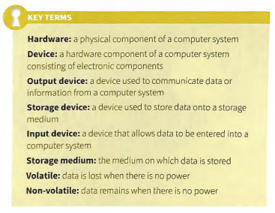
Key Terms

Slide 4
Hardware Device
An item of hardware is a physical component that forms part of a computer system. Items of hardware are often known as devices because they comprise electronic components . Hardware devices can be internal to the computer system (such as the central processing unit, memory or motherboard) or they can be external to the computer system (such as the monitor, keyboard or mouse).
Hardware is categorised into input, output and storage devices. Input devices allow data to be sent to a computer (e.g. keyboard). Output devices allow the communication of data/information from a computer (e.g. monitor). Storage devices store data onto a storage medium so that it can be used at a later time .

Slide 5
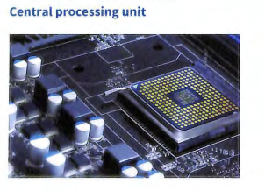
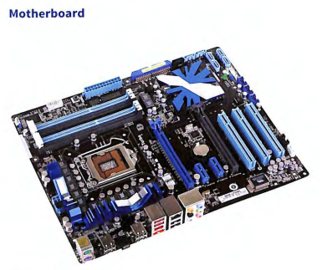
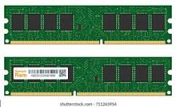
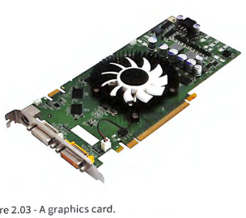
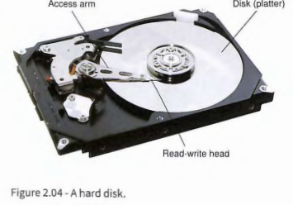
Internal Hardware Devices

Slide 6
CPU
The central processing unit (CPU) is the brain of a computer. It is the part of the computer that carries out calculations, executes instructions and processes data. It includes the arithmetic logic unit (ALU) and control unit (CU).
The ALU performs calculations and logical operations. The CU runs the fetch-execute cycle which fetches instructions from memory and executes them. Input data is taken from input devices (such as a keyboard) or storage and processed by the CPU, which produces output data that can be stored or sent to an output device (such as a monitor). CPUs usually consist of multiple cores . Each core is a separate processor, so a quad-core CPU has four processors. Processors are measured by the number of instructions they can process per second (hertz). A 3GHz (gigahertz) processor can process up to 3 billion instructions per second .

Slide 7
CPU
Companies that make processors
Intel
Nvidia
Qualcomm
Texas Instruments
AMD
IBM
Samsung
TSMC
STMicroelectroni

Slide 8
Motherboard
The motherboard is a printed circuit board (PCB) which connects the main components of a computer. Some of these components may be an integral part of the motherboard. Such components can include Universal Serial Bus (USB) ports , a network port and an integrated graphics card. A motherboard will always include the main bus which is used to transfer data between hardware components . Other hardware components can be connected directly to the motherboard, including random access memory (RAM), the CPU and expansion cards. Expansion cards offer additional functionality, such as enhanced graphics processing and additional USB ports .

Slide 9
RAM (Random Access Memory)
Random access memory (RAM) is memory that is used to store currently active programs and data. The more RAM that is available to the computer, the more data and programs can be used at the same time.
This is particularly important in multi tasking environments, when several prog rams may be open at the same time. When the RAM becomes full , programs or data that are no longer active will be removed to make space for new programs or data. If the RAM becomes full and there are no inactive programs or data to remove, then an area of secondary storage (e.g. hard disc drive (HDD) or solid state drive (SSD)) known as virtual memory is used to expand the amount of memory available to the CPU. Virtual memory is very slow because secondary storage access times are thousands of times slower than RAM access times.

Slide 10
RAM cont…
RAM is volatile , which means the content of t he memory is lost if the re is no power to the RAM. When you are using a computer and experience a power cut, this is why the data you are currently using is lost unless it has recently been saved to secondary sto rage. Read only memory Read only memory (ROM) is memory that, once it has been written to, can no longer be changed .
It is permanent and it is non-volatile , which means that when there is no power to the computer, the contents of the ROM will be retained. This is because it is powered by a small long-life battery

Slide 11
ROM ( Read Only Memory)
Read only memo ry (ROM) is memory that, once it has been
written to, can no longer be changed . It is permanent and it
is non-volatile , which means that wh en there is no powe r
to the comput er, the contents of the ROM will be retained.
This is becau se it is powered by a small long-life battery.
ROM is also used in small dev ices such as calcu lators
whe re there is only one program o r set of instructions.

Slide 12
Functions of ROM
– Storage of permanent data and instructions. ROM chips arе designed to storе data and instructions pеrmanеntly that arе writtеn oncе and cannot bе еasily modified. ...
– Role in booting up the computer system. ...
– Support for firmware and software programs. ...
– Preservation of critical system information.
BIOS (basic input/output system) is the program a computer's microprocessor uses to start the computer system after it is powered on.

Slide 13
Types of ROM
There are four main types of ROM:
Masked Read Only Memory (MROM),
Programmable Read Only Memory (PROM),
Erasable Programmable Read Only Memory (EPROM),
Electrically Erasable Programmable Read Only Memory (EEPROM).

Slide 14
Types of ROM
Mask ROM is a read-only memory whose contents are programmed by the integrated circuit manufacturer (rather than by the user). The desired memory contents are furnished by the customer to the device manufacturer.
PROM full form is programmable read-only memory. It is a type of non-volatile computer memory. This means that once data has been written to PROM, it cannot be erased. PROM is used to store programs or firmware for microcontrollers and other digital devices.

Slide 15
Types of ROM cont..
EPROM, form of computer memory that does not lose its content when the power supply is cut off and that can be erased and reused. EPROMs are generally employed for programs designed for repeated use but that can be upgraded with a later version of a program.
EEPROM (electrically erasable programmable read-only memory) is a user-modifiable ROM. It can be erased and reprogrammed (written to) repeatedly by applying an electrical voltage that is higher than normal. However,EEPROM is a type of non-volatile ROM that enables individual bytes of data to be erased and reprogrammed. That is why EEPROM chips are known as byte erasable ...

Slide 16
Class Activity one
Let us have four group(1,2,3,4)
Group 1,2 we tell us two purpose of PROM
Group 3,4 we tell us two purpose of EPROM
ROM in our mobile phone is what________________ then, state the reason from your own point of view (group 1,2)
BIOS stand form what________________the the type of ROM that host BIOS is what_______________________ state the reason from your own point of view

Slide 17
Graphic Card
A graphics card is also known as a video card, display adapter or graphics adapter. It is a printed circuit boa rd that co nnects to one of the motherboard 's expansion slots. Its purpose is to generate the signals needed to display the output image from the computer.
Often the graphics adapter is integrated into the motherboard and does not require a separate card . However, by using a separate card, the graphics performance can be impro ved as a separate processor can be used for graphics (a graphics processing unit ).

Slide 18
Graphic Card cont...
Graphics cards include a variety of options for output.
Standard video graphics array (SVGA) output to a monitor
is achieved through the RGB port which transmits red.
green and blue signals to the monitor in an analogue
format. High definition display is achieved through a
high-definition multimedia interface (HDMI) port. Another
option is Digital Video Interface (DVI) which supports high
resolution displays using digital signals.

Slide 19
Sound Card
The purpose of a sound card is to generate the signals needed to output sound from the computer to a speaker or set of speakers. It is often an integrated part of the motherboard and will include a single output for audiou (green socket) . a single input for a microphone (red socket) and a single input for line level devices (blue socket).
If higher quality or surround sound is required, then it is usually necessary to have a separate sound card which connects to one of the motherboard's expansion slots.This will enable multiple outputs for front, rear, cent re and sub-woofer speakers.

Slide 20
Hard disk drive
A hard disk drive (HDD) is the most common form of secondary storage for a computer due to its relatively low cost per MB (megabyte ). In 2015, hard disk drives could store up to 8 TB (terabyt es) of data with access speeds of6 GB/s. The hard disk drive consists of two main parts: the device that is the electronics which store the data, and the disk that is the medium onto which the data is stored. The device (or drive) includes a read-write head which sits at the end of an access arm and magnetises sectors on the disk (platter ).

Slide 21
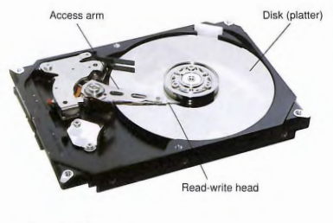
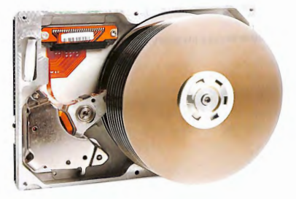
Hardisk

Slide 22
Harddisk cont...
A magnetic disk is made up of disks (platters), the read and writes heads which are held in place by an arm (actuator), and the spindle which holds platters together. The platters are coated with magnetic materials on both sides for data storage. The actuator makes sure that the read and write head moves to the disk location where data need to be read or written to.
The platters are divided into tracks and sectors which are used to define a certain location. The more tracks and sectors the higher the disk capacity. Also, the number of platters depends on the intended capacity of the disk. The disk and all other components are enclosed together in a hard drive.Low-level formatting is done to a new disk to create tracks and sectors to enable the R/W head to write data. The other type of formatting is high-level formatting which is done to the disk that you want to install the operating system.Parts of a magnetic disk drive

Slide 23
Hardisk
Platter: It is a metallic disk that can be magnetized or demagnetized to read or write data on it
Tracks: These are concentric circles that run around the surface of the platter
Sector: it is the specific location where data is stored. It is identified by indicating the platter and the track number.
Read/Write head: This is the electronic head that is used to read or write data to the specific sector of the disk.
Spindle: It is the central point where the platter rotates from. It holds platters together to enable them to rotate
Actuator (Read/write arm): this is the mechanism that holds the head in position
Cylinder: this is a collection of tracks from different platters that are under the read/write head at a particular time.

Slide 24
SSD(Solid State Drive)
Solid state drive A solid state drive (SSD) is another secondary storage device that is non-volatile. However, there are no moving parts and the data is stored onto flash memory. It is also not necessary to store data in the same cylinder in order to maximise access speed as the data can be stored anywhere on the flash memory and access speeds will not be affected. SSDs are also non -magnetic and so are not susceptible to damage from to close, strong magnetic fields. In 2015, SSDs could store up to 8TB, but due to the newer technology were far more expensive than HDDs and were more common in capacities of 128, 256 or 512 GB.
SSDs have access speeds of around 400 -600 MBps (two to three times faster than a HDD). This means they are used in higher performance computer s. A frequent compromise between speed, capacity and price is to have a smaller SSD to store the operating system and softwa re (for speed of access) and use a larger HDD to store data.
SSDs also require a lot less power than HDDs and so are preferred in laptop and tab let computers.

Slide 25
External Hardware Device(Cloud)
Cloud computing is a term that refers to anything where computing services are hosted over the internet and not in the same physical location as the computer being used.
Data is stored on banks of servers that are accessed remotely. The physical devices that store the data are owned by a hosting company rather than the person or organisation using the data .

Slide 26
Cloud
Examples of cloud storage for personal use include:
• OneDrive
• Google Drive
• Dropbox
• Box
Cloud services providers
1. AWS (amazon web services)
2. Azure(Microsoft)
3. Google Cloud
4. Cloudflare
5. UpCloud
6. LotusFlare

Slide 27
External Hardware Device(Monitor)
Monitor: is certai nly an essential part of most computer systems as it enab les the user to visualise the output. It is connecled to the computer using one of the ports on a graphics card. Monitor sizes are measured diagonally and , apart from some very old 'legacy ' monitor s, they now have flat screens which minimalise the amount of desk space that is used and they are light enoug h to be mounted on a wall or a desk using a bracket or on a shelf.
A monitor will be limited by its resolution . This is the number of pixels it can display and is measured horizontally by vertically. For example, a high definition (HD) monitor can display 1920 x 1080 pixels. Some monitors also include a touch interface (known as a touch screen), which means that the user can select items by directly interact ing with the display on the screen. These are often integrated into tablet computers and mobile phones.

Slide 28
External Hardware Device(Keyboard)
A computer keyboard is an input device used to enter characters and functions into the computer system by pressing buttons, or keys. It is the primary device used to enter text. A keyboard typically contains keys for individual letters, numbers and special characters, as well as keys for specific functions

Slide 29
External Hardware Device(Mouse)
A mouse is a pointing device which allows objects to be selected and manipulated on the screen. The mouse controls a pointer which is displayed on the screen. When the mouse is moved, the pointer moves and objects such as menus can be selected on the screen using one of the mouse buttons. Like a keyboard, a mouse can be connected using a USB port, by wireless Bluetooth or by other wireless technology.

Slide 30
External Hardware Device(Printer)
A printer produces a hard copy (printout) from a computer usually onto paper. A simplex printer can print on a single side of paper , whereas a printer with a duplex unit can print on both sides of each sheet of paper .Some pr inters include additional functions such as a scanner.
Laser printer
A laser printer negatively charges a cylindrical drum which then attracts electrically charged toner (powde red ink). The toner is then heated so that it melts onto the paper.
Inkjet printer
Cartridges full of ink in four different colours (black, cyan,magenta, yellow) are used to 'squirt ' ink onto the paper to form the required printout.

Slide 31
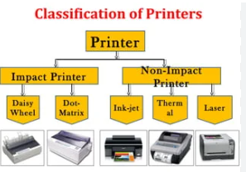
Classification of Printers

Slide 32
Impact Printer
Impact Printer e.g Ball printers, Dot-matrix, Daisy wheel printers, Line printers, Drum printers, and Chain printers
Non- Impact Printer e.g inkjet, thermal, mobile, laser, large-format, etc.

Slide 33
Dot matrix printer
Dot matrix printer Before laser and inkjet printers, dot matrix printers were commonplace . They are a type of impact printer which means that the printout is achieved by hittingthe paper and the operation is very noisy . This is done by a set of pins being driven onto a ribbon which then transfers its ink to the paper .
The main advantage of dot matrix printers is that they can print on duplicate and triplicate paper (carbon copies) due to the impact.
They are also very robust printers and so last for a long time .

Slide 34
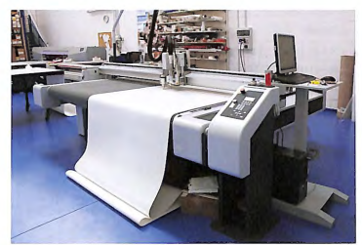
External Hardware Device(Plotter)
Plotter In the 1990s, a plotter used to 'plot' lines onto large sheets of paper by moving the paper backwards and forwards and drawing using pens to create vector drawings. Today, plotters are inkjet printers designed to be used with largesheets of paper. typically A2, Al and AO. If only black and white printouts are required, then light-emitting diode (LED) plotters are much faster and have cheaper running costs than inkJet plotters.

Slide 35
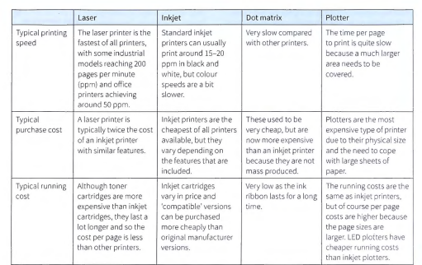
Differences and Similarities between printers

Slide 36
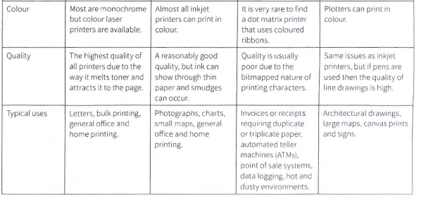

Slide 37
External Hardware Device(Speaker, Camera,Webcam)
Speakers are used to provide sound output from a computer. These can be as simple as a pair of stereo speakers or full surround sound.
Camera A camera can be used to capture still or moving images (movies). When connected to the computer , the images or movies can be transferr ed from the camera to the computer's storage. The images can then be viewed onscreen, man ipulated and shared. A dig ital sti ll camera is optimised for capturing still images but usually has the capability of capturing movies too, whereas a digitalvideo camera is optimised for captur ing mov ies but can also capture still images .
A webcam is a camera that is connected to the com puter for the pu rpose of captur ing still or moving images whi le using the computer . It will no t be as high quality as a dedicated dig ital camera or digital video camera . It will usually have an integrated microphone for capturing sound . Its main purpose is for users to engage in online video chat or video conferences They can also be used assecurity cameras.

Slide 38
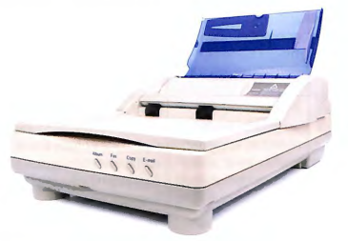
External Hardware Device(Scanner,OCR,OMR)
A scanner is used to capture two dimensional (2D) documents in the form of an image. They perform a similar function to a digital camera but are specifically designed to take close-up image of 2D document . Flatbed scanners can capture a full-colour image and save the image as a file on the computer storage. If the image contains lot of text. then it is possiblerun Optical Character Recognition (OCR) to recognise the text. Some flat-bed scanners include an automatic docum ent feeder(ADF) that enables documents with multiple pages to be scanned in one operation .

Slide 39
Optical character reader
An optical character reader (OCR) is a device that enables characters on a document to be identified and understood by the computer as letters, numbers,characters and words. This isn't really a device in itself, but is a scanne r comb ined with softw are that performs optical character recognit ion (also OCR). The picture of the document is analysed and characters are recognised by the software and turned into a document so that the text can be searched or edited.

Slide 40
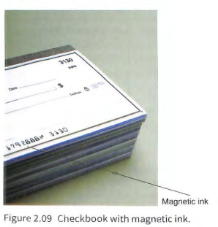
Magnetic Ink Character Reader (MICR)
Magnetic ink is used to print numbers at the bottom of checks. The numb ers are printed using the MICR E-138 or CMC-7 font. The ink contains iron oxide which means that it is easily detected when using a magnetic ink cha racter reader (MICR) and the characters can be und ersto od. It is important that mistakes aren't made and so MICR provides a much better level of accu racy than OCR.

Slide 41
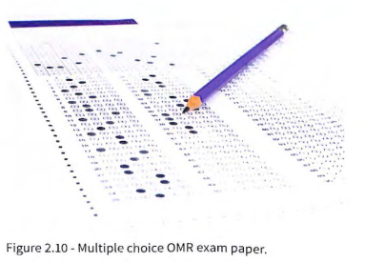
Optical Mark Reader (OMR)
An optical mark reader (OMR) detects the marks that are made on a multiple choice document such as a multiple choice answer paper for an exam in ation. A scanner-like device is used to reflect a beam of light o nt o the marked sheet and detect where the marks have be en made. So ftw ar e is then used to t ranslate the po sition of t he mark to the info rmat io n that it repr ese nt s. OM R devices are only really suitable for multiple choice responses as they cannot interpret lett ers that form words.

Slide 42
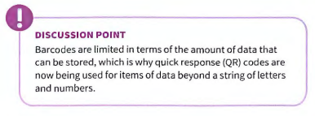
Barcode Reader
A barcode reader is used to detect the width of lines and gaps that form a barcode. A laser beam is shone onto the barcode and a photodiode is used to measure the amount of light that is reflected back. Black lines will not reflect any light but white gaps will. A barcode represents letters and number s which usually identify some thing, such as a book or other product .
The barcode scanner usually inclu des it s own hardcoded circuitry so that it can send the letters and numb ers directly to the computer without the need for additional software .

Slide 43
External Hardware Device(Pen drive)
A pen drive is a nick name for a USD flash drive. It is a small data sto rage device about the size of a thu mb which stores data on flash memory and includes an integrated USB interface. The USB interface means th at the flash drive is recognisable on all computers with a USB port and therefore data can be transported easily between computers.
Flash memory is very fast and so t he limiting facto r is the speed of the USB port. As a flash drive does not have any moving parts it is safe to tr anspo rt, although its size means t hat it can be easily lost. It also does not relyon magnetising and therefore is not susceptible to damage if it comes in contact with a strong magnetic field.

Slide 44
precious.a@westerfieldcollege.com
preye.d@westerfieldcollege.co

Slide 45
Blu-ray disc drive
A Blu-ray disc is an optica l storage medium. It is the same size and shape as a compact disc (CD) and digital versatile disc (DVD). The Blu-ray disc was introduced because it can store HD video and therefore a whole film can be stored on the Blu-ray disc. A single layer Blu-ray disc can store 25 GB of data and a dual-layer Blu-ray disc can store 50 GB of data . This compares to a DVD which can store 4.7 GB of data and a CD whic h can sto re 700 MB of data (or 80min utes of audio ). A Blu ray disc drive is required to read data from or write data to a Blu-ray di sc. It uses lasers to read data that has been written in 'pits'. A basic Blu-ray disc drive can read data at 4.5 MB/ s, whereas a 16x Blu-ray drive can read data at 72 MB/ s. This is much slower than a HDD but the discs are very cheap to purchase compared with a whole HDD.
A standard Blu-ray disc is read only and used to distribute HD movies . However, it is possible to buy recordable (Bluray) discs that can be written to once and are useful for archive and backup purposes, or rewritable (Blu-ray) discs which can be rewritten to and erased making them useful for both backup and data transfer purposes.
DISCUSSION POINT:
Find out about the next advancement in optical storage,
the holographic versatile disc (HVD)

Slide 46
External Hardware Device(Memory card,Portable Hardisk Drive)
A Memory Card is flash memory on a small card. They are typ ically used in digital came ras, digital video cameras and mobile phones . They take up very little space so are well suited to fitt ing into a small device, as well as being portable so that data can be transferred to a computer. There are many differe nt formats of cards, but most devices favour Secure Digital (SD) and microSD cards. MicroSD cards are only 15 x 11 x 0.7 mm in size.
Portable Hard Disk Drive
Hard disk drives were introduced earlier in this chapter . As we ll as an internal HDD, it is possible to have an external HDD. An external HDD can be connected to the comp uter using a USB or External Serial Advanced Techno logy Attachmen t (eSATA) port. An external HDD can store a lot mo re data than a USB flash drive, but it is more susceptible to damage due to it having moving parts and its vulnerability to strong magnetic fields.

Slide 47
External Hardware Device(Storage Devices)
Remember
The main purpose of a stora ge device is to store data or software that can be used by a computer . A storage device is known as secondary storage, which is non -volatile and so dat a is not lost when the comput er is turned off.

Slide 48
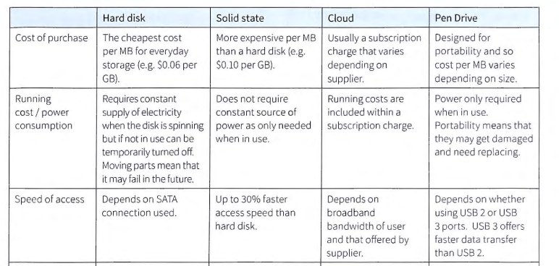
Comparing Storage Devices

Slide 49
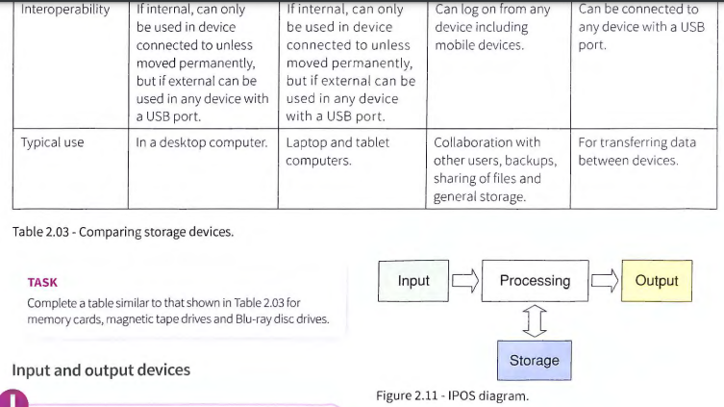
Comparing Storage Devices

